Slide 1
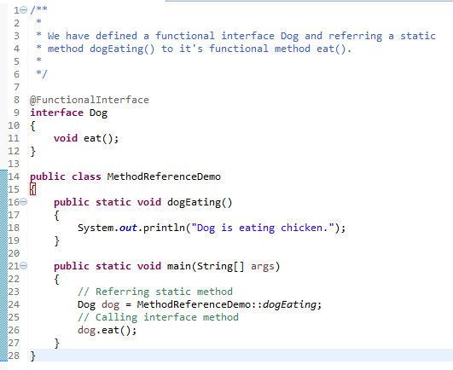
Java Method References
Java provides a new feature called method reference in Java 8.
Method reference is used to refer method of functional interface. It is compact and easy form of lambda expression.
Each time when you are using lambda expression to just referring a method, you can replace your lambda expression with method reference.
Referring

Slide 2
Java Method References
Types of Method References
There are four types of method references:
Reference to a static method.
Reference to an instance method of a particular object.
Reference to an instance method of an arbitrary object of a particular type.
Reference to a constructor.

